Slide 1
SALES FORECASTING FOR SUPERSTORE SUPERMARKET

Slide 2
Introduction
Superstore is a very large supermarket based in the United States of America with presence in all the states. They are best known for sale of office supplies, furniture and Technology supplies such as phones. Using Historical data, the company wants to forecast their future sales so as to plan and make informed decisions about future operations, marketing, and resource allocation.
Accuracy in sale prediction helps firms to adjust their strategy accordingly, anticipate future demand and identify potential problems or opportunities. Sale forecasting is a very key task that businesses need to embrace.

Slide 3
Objectives
Superstore want to strategize their inventory management, logistics, production and manpower planning for the future. The business problem this project is to forecast future sales data by training supervised machine learning models on historical data.

Slide 4
Data Understanding
The dataset contains the historical order details of the customers of the superstore in all the stores in the United States. This is monthly data for shipped goods from the month of July in the year 2014 to May 2018.
The dataset contains 9994 rows and 21 Columns

Slide 5
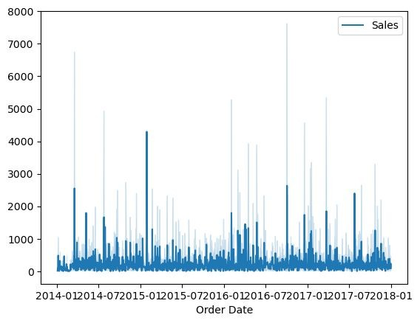
Exploratory Data Analysis
#Visualizing the dataset using lineplot
sns.lineplot(data)
<Axes: xlabel='Order Date'>

Slide 6
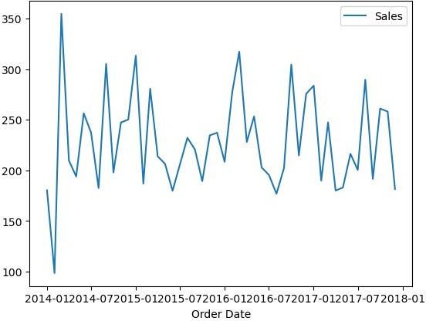
#Visualizing the monthly sales dataset using lineplot sns.lineplot(monthly_data)

Slide 7
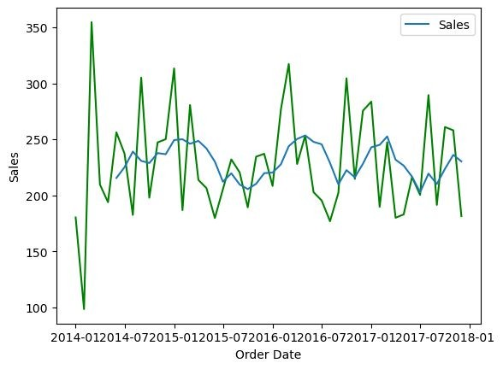
Checking for Trend
<Axes: xlabel='Order Date', ylabel='Sales'>
#Checking for trend using rolling mean
# comparing the two lineplot

Slide 8
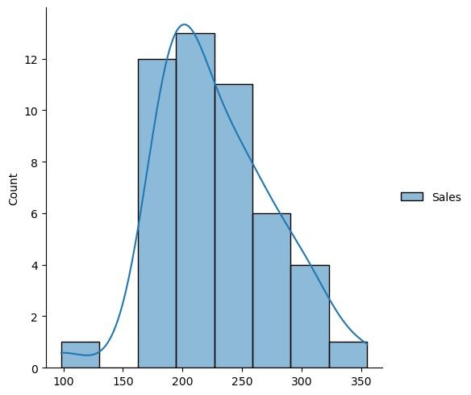
# visualizing the distribution of the dataset sns.displot(monthly_data, kde=True)

Slide 9
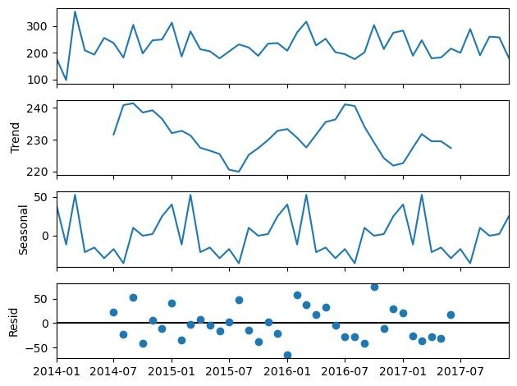
#Checking for sattionarity using dickyfuller test on monthly data

Slide 10
output = adfuller(monthly_data)
Output
(-3.2865668298704307,
0.015489720191097255,
10,
37,
{'1%': -3.6209175221605827,
'5%': -2.9435394610388332,
'10%': -2.6104002410518627},
376.49084160927134)
*Ho : it is non-stationary
*H1 : it is stationary
If p< 0.05 ; Data is stationary
if p>0.05; Data is not stationary
Since the p-value is 0.00020180198458237758 ,which is less than 0.05 we conclude that the data is stationary

Slide 11
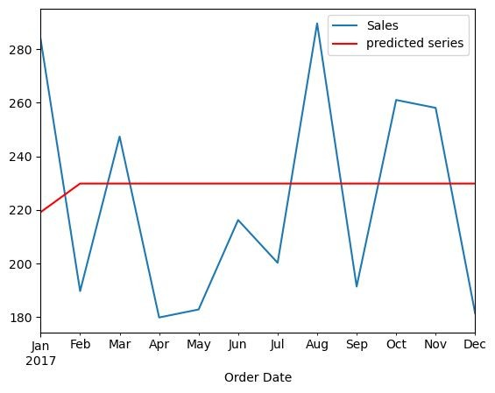
Modelling
ARIMA Model
# plotting the test set(actual) and predict model(forecast) to see a comparisson # Plot forecasts against actual outcomes
ARIMA Model - MSE: 1748.62, RMSE: 41.82

Slide 12
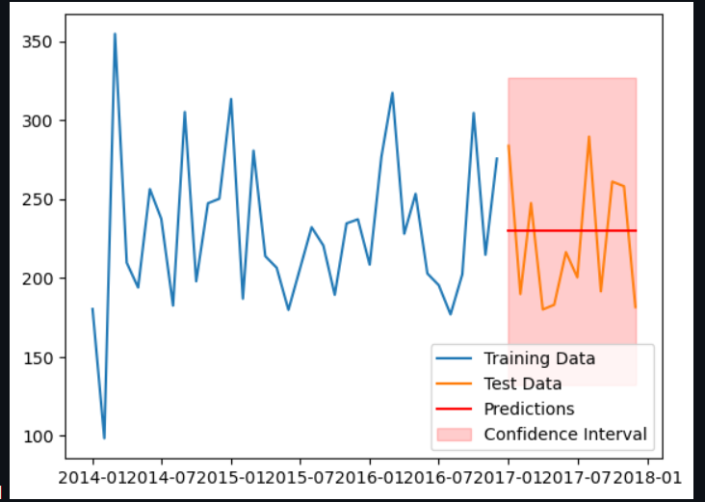
PMDARIMA Model
plotting the test set(actual) and predict model(forecast) to see a comparison Plot forecasts against actual outcomes
PMDARIMA Model - MSE: 1640.99, RMSE: 40.51

Slide 13
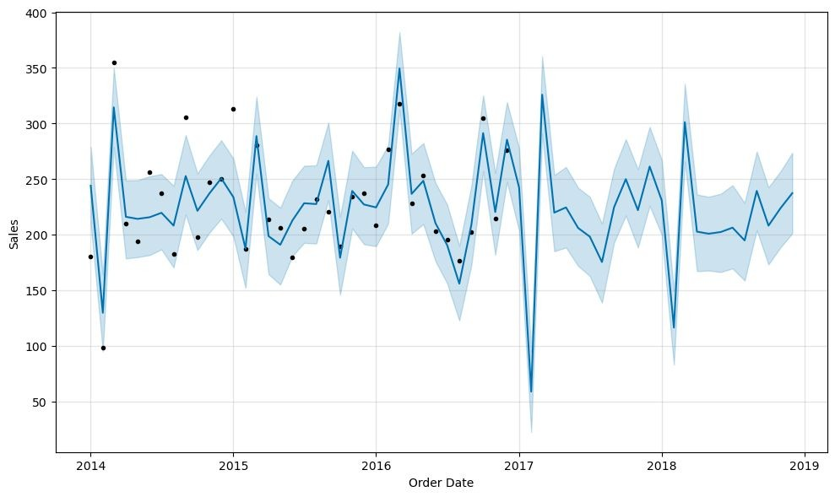
Facebook Prophet Model
# Plot the original data and the forecast
fig = prophet_model.plot(forecast, xlabel='Order Date', ylabel='Sales')

Slide 14
Findings and conclusion
Based on the provided analysis, the model evaluation metrics for the three models are as follows:
ARIMA Model : Best ARIMA Order: (0, 1, 1) AIC: 505.25 MSE: 1707.47 RMSE: 41.32
PMDARIMA Model: AIC: 387.39 MSE: 1640.99 RMSE: 40.51 Facebook Prophet Model:
MSE: 2544.91 RMSE: 50.45
Given the MSE and RMSE values, the PMDARIMA model is the best model because it has the lowest MSE and RMSE values. Arima Model is the second best model followed by Facebook Prophet model. Facebook prophet model has the highest MSE and RMSE values, indicating higher prediction errors compared to the ARIMA models.
Therefore, based on the provided metrics , PMDARIMA model is the best choice for this specific forecasting task.

Slide 15
Recommendations
This study recommends increased use of digital marketing strategies to promote sales in future.
The sales team should also consider discounts in future so as to entice customers thereby increasing sales.
However, since there is probability of decline in sales in the future, the Company should avoid overstocking.
Further analysis and consideration of additional factors could also help make a more informed decision.

